Slide 1
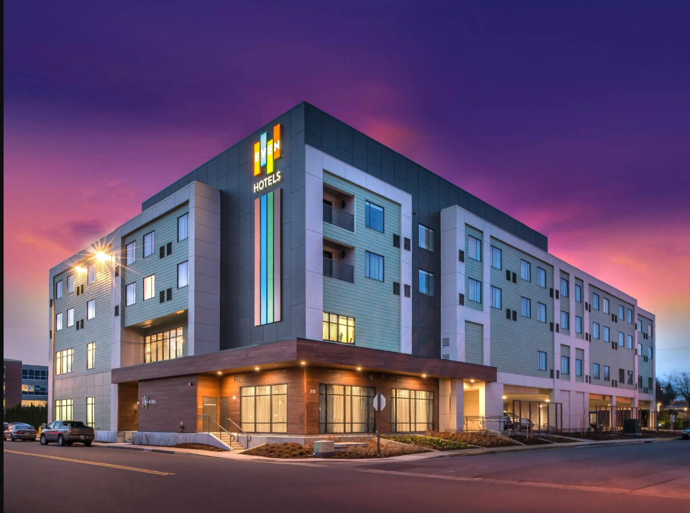
ExcelR Solutions
P346 – NLP - HOTEL REVIEW ANALYSIS

Slide 2
Presented by
Prathmesh
Sanish
Praneeth
Amulya
Ameena
Manasi
Akshatha
Samrudh

Slide 3
CONTENTS
BUSINESS OBJECTIVE
WORKFLOW
EXPLORATORY DATA ANALYSIS
SENTIMENTAL ANALYSIS
FEATURE ENGINEERING.
MODEL BUILDING

Slide 4
Business Objective
Analyzing 20,000 hotel reviews and ratings, this dataset explores how travellers articulate positive and negative experiences online. The primary goal is to pinpoint attributes influencing hotel selection. Insights from this examination empower managers to enhance specific elements, thereby improving brand image. The focus is on unravelling the factors that lead to positive reviews, guiding hoteliers to strategically elevate guest satisfaction. This research equips managers to make informed decisions, amplifying overall hotel success in the competitive hospitality landscape.

Slide 5
Workflow
Exploratory Data Analysis
Sentimental Analysis
Feature Engineering
Model Building
Model Selection
Deployment

Slide 6
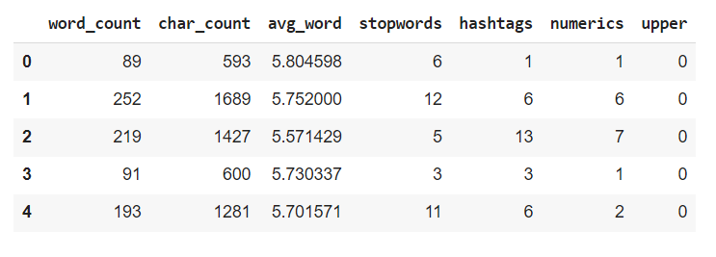
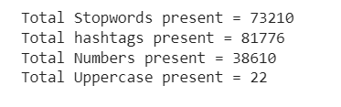
Exploratory Data Analysis:-
Exploratory Data Analysis (EDA) is a crucial step in understanding the patterns, relationships, and potential insights hidden in your data.

Slide 7
In the exploratory data analysis (EDA), various linguistic features were computed from the dataset of 20,000 hotel reviews. This included determining the count of stop words used, tracking the frequency of hashtags employed in the reviews, and calculating the number of uppercase letters present in the text.
The comprehensive examination of these linguistic features enhances our understanding of the textual nuances within the dataset, contributing to a more nuanced interpretation of the sentiments and expressions conveyed by the reviewers.
Text Cleaning: During text cleaning, instances of 'No Negative' and 'No Positive' were eliminated from the text, streamlining sentiment analysis. Additionally, part-of-speech tagging was employed to assign grammatical tags to each word, aiding in categorizing them as nouns, verbs, etc. This enhances the understanding of the linguistic structure within the dataset. The utilization of the WordNet lexical database further refines the tagging process, ensuring accurate linguistic classifications

Slide 8
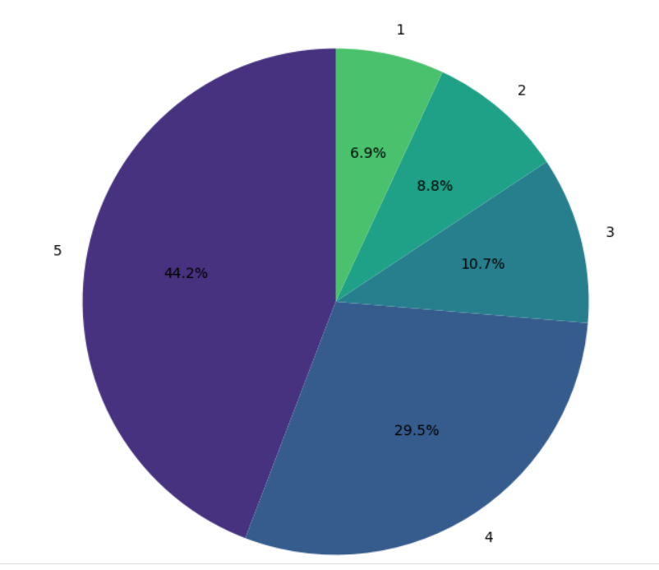
DISTRIBUTION ON RATINGS

Slide 9
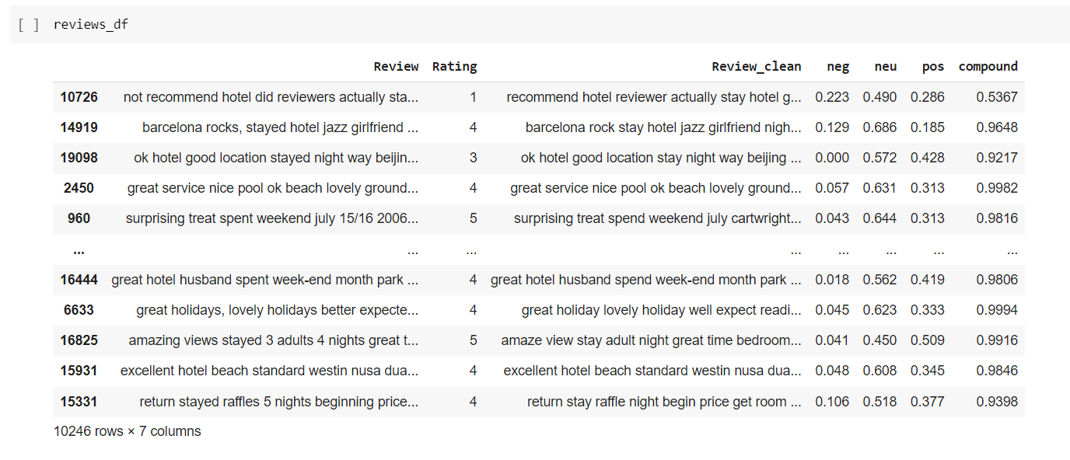
Sentiment Analysis
We use the SentimentIntensityAnalyzer from the NLTK library to evaluate the sentiment of textual data stored in a DataFrame. The SentimentIntensityAnalyzer assigns positive, negative, neutral, and compound sentiment scores to each entry in the "Review_clean" column of the DataFrame. These sentiment scores are then added as new columns named "positive," "negative," "neutral," and "compound" to the original DataFrame, providing a detailed sentiment analysis for each text entry.

Slide 10
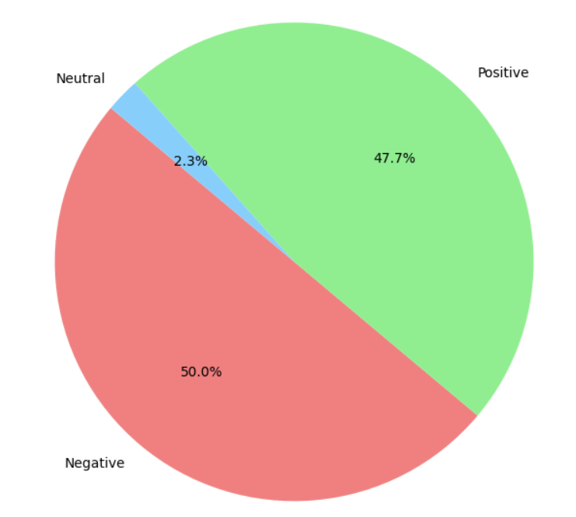
Feature engineering
In the process of feature engineering, we utilize data resampling techniques to ensure a balanced representation of both positive and negative reviews, promoting fair and effective model training.

Slide 11
MODEL BUILDING
Splitting data into train and test sets.
Building the Decision tree classifier, Random Forest Classifier, KNeighborsClassifier, XGBClassifier, LGBMClassifier, MultinomialNB, BernoulliNB, AdaBoostClassifier.
Comparison of the Accuracy score of all the applied models.

Slide 12
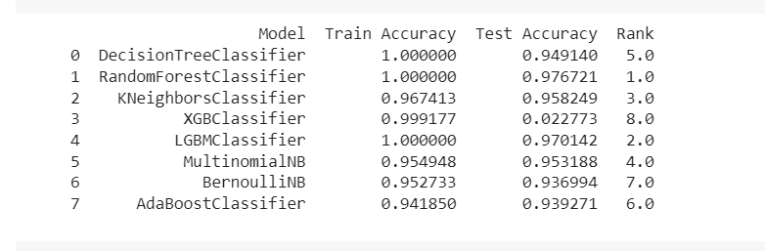
Accuracy score comparison

Slide 13
Model Selection
After conducting a thorough comparison of different models, it was observed that the Random Forest model exhibited the highest accuracy score, indicating superior performance among the evaluated models.

Slide 14
Deployment
Streamlit is used for deployment of the project.

Slide 15
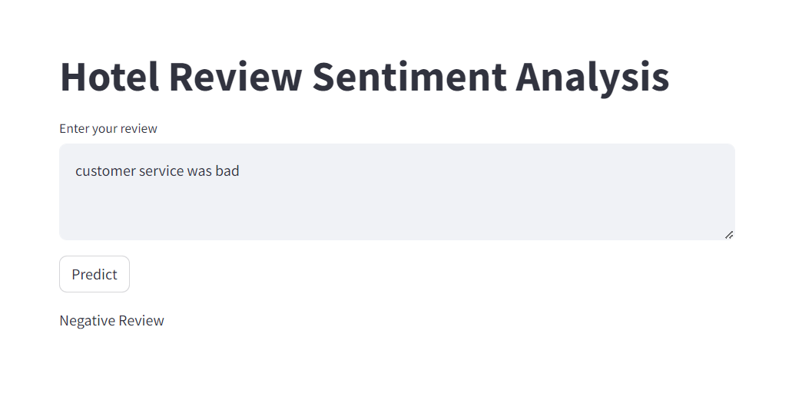
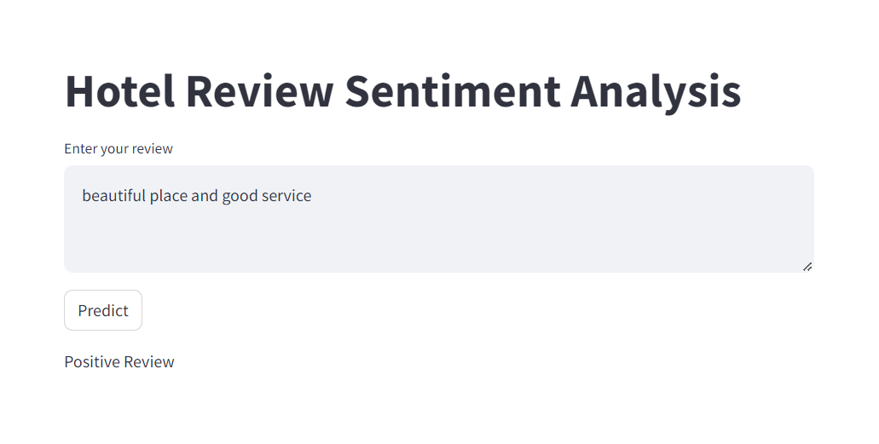

Slide 16


